Slide 1
One year after María… How is Puerto Rico faring and how are we planning for the next disaster?
Puerto Rico Disability Community Relief Network
October 11, 2018

Slide 2
Our Island
Located between the Caribbean Sea and the North Atlantic Ocean, east of the Dominican Republic and west of the Virgin Islands.
It is comprised of various smaller islands and cays, including Vieques, Culebra, Mona, Desecheo, and Caja de Muertos.
Puerto Rico has 78 municipalities, including Vieques and Culebra.
Only Culebra and Vieques are inhabited year-round.

Slide 3
Puerto Rico Map

Slide 4
A USA Territory
Puerto Rico is a territory of the United States
With an Hispanic heritage, culture, religion and language
PR has unbreakable bonds with all Caribbean, Central and South American countries of Hispanic origin
Puerto Ricans are American citizens
Legal and illegal immigration of other Hispanics into Puerto Rico, is quite common

Slide 5
DEMOGRAPHICS

Slide 6
Demographics As Of 2012-2016
Median age: 39
Percent of the population:
Under 5 years: 5.2%
18 years and over: 78.3%
Age 65 and over: 17.4%
Speak Spanish 94.3%
Speak only English 5.5%
Persons below poverty level: 45.1% (compared to 15.1% for US)
Source: U.S. Census Bureau,
2012-2016 American Community Survey 5-Year Estimates

Slide 7
ECONOMICS

Slide 8
Puerto Rico’s Economics
Traditionally Puerto Rico has been considered the poorest jurisdiction of the United States
Population 3,529,385 (ACS 2012-2016)
One fourth of the population lives in poverty
Poverty level of working people with disabilities is higher than the population without a disability. (2016)
50.5% versus 38.4 % poverty level

Slide 9
Income and Poverty Level
PR compared to the states and the nation
Location | Per Capita PAS 12 months 2012-2016 | Persons Below the Poverty Level (2012-2016)
Connecticut | $39,906 | 10.4%
Florida | $27,598 | 16.1%
Hawaii | $32,634 | 10.8%
New Jersey | $38,911 | 10.9%
Nueva York | $34,212 | 15.5%
Puerto Rico | $11,688 | 45.1%
Texas | $27,828 | 16.7%
US | $29,829 | 15.1%
Source:
U.S. Census Bureau,
2012-2016 American Community Survey 5-Year Estimates

Slide 10
Disability Employment Rate (2016)
People without disabilities- 58.6%
People with Disabilities- 23.1 %
Gap- 35.5 percentage points

Slide 11
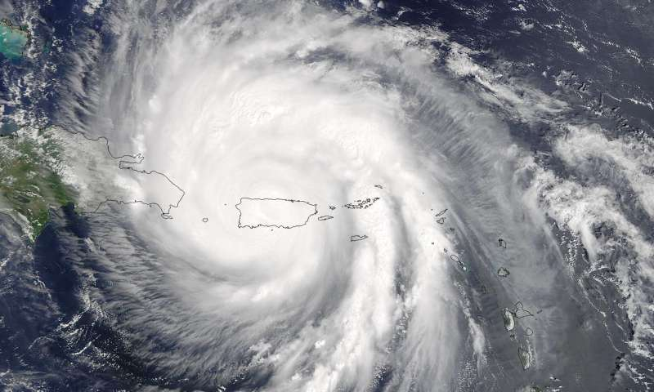
HURRICANE MARIA

Slide 12
Hurricane Maria
On September 20, 2017 Puerto Rico suffered the onslaught of Hurricane Maria, an atmospheric event that changed the lives of Puerto Ricans, including the lives of people with disabilities.

Slide 13
Impact On The Island (Part I)
Category 4 hurricane with sustained winds of up to 155 miles per hour
Up to 40 inches of rainfall that caused river overflows and flooding across all the island
Ocean waves up to 25 feet high
It impacted the whole island of Puerto Rico, crossing diagonally by entering the island through the southeast (Yabucoa) and exiting through the northwest (between Barcelona and Arecibo).

Slide 14
Impact On The Island (Part II)
100% of the island with no power
60% of the island without water
100% of the municipalities lost total communication when 92.7% of the communication towers fell due to the winds.
Cell phones did not work.
Internet connection was almost totally gone, with very limited connectivity in only the San Juan metropolitan area

Slide 15
Impact On The Island (Part III)
Hundreds of gas stations were destroyed. Those that were able to re-open began seeing lines that went on for kilometers of people needing gasoline for their cars and generators. Many people made lines for 4-12 hours, sometimes in vain because the gasoline would run out.
Only one am radio station was operational. News channels were down.
98% of the planted adult trees were uprooted.

Slide 16
Impact On The Island (Part IV)
Bridges collapsed, roads were totally wiped out leaving some communities completely isolated, without access to food, supplies, medications, etc.
The majority of the island’s hospitals lost power. The following day only 7 of the hospitals were operational with generators.
Emergency personnel had to rescue approximately 2,000 people in boats during the night due to the flooding of homes.

Slide 17
Impact On The Island (Part V)
80% of the agricultural crops were destroyed, representing approximately 740 million dollar losses.
An estimated 472,000 homes sustained damages; approximately 25,000-30,000 were totally destroyed
The original estimate of 64 deaths was later criticized and questions arose when later studies from the University of Harvard and George Washington University estimated deaths at 2,975-4,600.
Source: El Nuevo Día Newspaper, September 2018

Slide 18
Ascertainment of the Estimated Excess Mortality from Hurricane María in Puerto Rico (2018)
Total excess mortality post-hurricane using the migration displacement scenario is estimated to be 2,975 (95% CI: 2,658-3,290) for the total study period of September 2017 through February 2018.
The risk of death was 45% higher and persistent until the end of the study period for populations living in low socioeconomic development municipalities, and older males (65+) experienced continuous elevated risk of death through February.
Source:
Milken Institute School of Public Health,
The George Washington University

Slide 19
Data Revealed By The Government
68% of the people who died between September and December of 2017, when PR was mired in the catastrophe caused by hurricanes Irma and María, were people over 70 years of age.
Data revealed by the Demographic Registry also established that almost half of the deaths recorded in this period occurred among people who were hospitalized in various medical institutions of Puerto Rico. In addition, the risk of death was more inclined toward men. 54% of the deceased were male, when this group represents 48% of the population of Puerto Rico.

Slide 20
Data Revealed By The Government (Cont.)
Similarly, deaths attributed to diseases such as Alzheimer's, diabetes, septicemia, pneumonia and chronic conditions in the heart or airways showed significant increases in the period that followed the storm.
Source:
Milken Institute School of Public Health,
The George Washington University

Slide 21
Migration
Some preliminary estimates from the local government suggest that some 270,000 people left the country after hurricanes Irma and María, which occurred in the month of September.
Meanwhile, data on the movement of passengers show that in September and October, 124,974 more people left than those who arrived in the same period. This migration indicator suggests that Puerto Rico lost 3.7% of its population in those two months.
In fact, in the month of October, 85,502 more people left than they arrived. This figure is higher than the one recorded for all the 12 months of 2016 (El Nuevo Día, January 2018).

Slide 22
Hurricane María
Notes:
Hurricane didn’t only affect PR but many of the US states as well.

Slide 23
Mental Health Crisis
Puerto Rico was facing a galloping mental health crisis. Besides working to restore electricity and basic needs to residents after Hurricane María’s destructive impact, state officials were also scrambling to meet the mental health needs of Puerto Rico residents. The number of suicide-related calls to the suicide prevention hotline doubled from 2,046 in August to 4,548 in January, according to the Health Department statistics. Suicide attempts also climbed from 782 in August to 1,075 in January. (Carrie Cochran/USA TODAY Network, Rick Jervis/USA TODAY).

Slide 24
Level Of Poverty
The Census Information Center (CIC) of the University of Puerto Rico in Cayey (UPR-Cayey) revealed, in an analysis of the possible level of poverty in the island because of the hurricane, that the poverty rate has gone from 44.3% to 52.3% (La Perla del Sur, November 2017).

Slide 25
Shelters
Only one special shelter for people with access and functional needs in the metropolitan area.
Most people from outside the metropolitan area could not access this facility because of transportation or simply did not want to leave their communities.
Shelters across the island did not have generators to provide electricity. Others had generators but did not have enough fuel to power them.

Slide 26
Agencies and Hospitals
Hospitals were destroyed; many were closed while others were providing partial services. Those providing services were working with generators.
Diesel was not readily available, thereby causing the hospitals to limit services or completely shut down. Many people needing and requesting services were denied services because hospitals were only accepting critical cases.
Dialysis centers were damaged and had no electricity; services did not restart until 1-2 weeks after the hurricane.

Slide 27
Assistive Technology/Medical Teams
Many people with disabilities lost assistive equipment during the hurricane.
Insurance plans denied replacement; FEMA was slow in providing them because they required the survivor’s insurance plan denial; most suppliers were not yet working because of their own losses.
People had no wheelchairs, hearing aids, and other critical equipment for daily living.

Slide 28
Assistive Technology/Medical Teams (Cont.)
People within the shelters did not have immediate access to medical services within the shelters.
Medical conditions worsened, and hospitals were not equipped to receive them.

Slide 29
Personal Assistance/Communication
Family members, many of whom are the sole caregivers of bedridden people with disabilities, had to leave the homes in search of supplies or to coordinate disaster aid. Consequently, their bed ridden members were left alone for hours with no alternate caregivers.
Many bedridden people require personal assistants, but Puerto Rico does not have sufficient funds to cover these needs.

Slide 30
Personal Assistance/Communication (Cont.)
The deaf population had no idea as to what was happening. Therefore, they were not aware of the response efforts or services available to assist them because there was no way for them to get the information.

Slide 31
Response Initiatives In Municipalities And State Agencies
The central government of Puerto Rico had virtually no communication with its local government, so the extent of the damages were not known.
Response efforts were greatly hindered by this lack of communication.

Slide 32
Lack Of Alternative Energy Sources
People began relying on generators. Some communities had been without electricity since Hurricane Irma, which had struck two weeks earlier.
People with disabilities that required medical equipment 24/7 were required to purchase generators to sustain their lives. However, these generators were not meant to run 24/7. Consequently, many broke down requiring PWDs to use what little funds they had to purchase more generators and gasoline.

Slide 33
Lack Of Open Pharmacies
Lack of operating pharmacies created a shortage of medications.
Oxygen producers on the island were decimated; creating a shortage of oxygen supply in the island.
What little oxygen arrived was supplied to hospitals.

Slide 34
Lack Of Open Pharmacies (Cont.)
Individuals that requested oxygen at the hospitals were denied.
People with oxygen needs were not getting the oxygen; conditions worsened, people died.

Slide 35
PUERTO RICO DISABILITY COMMUNITY RELIEF NETWORK (PRDCRN)

Slide 36
Puerto Rico Disability Community Relief Network (PRDCRN) Is Born….
Movimiento para el Alcance de Vida Independiente (MAVI)
Protection and Advocacy System of Puerto Rico
Puerto Rico Assistive Technology Program
Puerto Rico Developmental Disabilities Council
University Center for Education on Development

Slide 37
Movimiento para el Alcance de Vida Independiente
MAVI (according to its initials in Spanish) promotes the independence, productivity, and inclusion of people with disabilities through the Philosophy of Independent Living, which gives people control in making decisions about their lives.
Who We Are
Betzaida Ramos, Executive Director

Slide 38
Protection and Advocacy System of Puerto Rico
Is the government agency that protects the rights of the population with physical, mental or sensory impairments and address their problems, need and complaints.
Who We Are
C. Janet Collazo, Executive Director

Slide 39
Puerto Rico Assistive Technology Program
Its main goal is to improve the quality of life of people with disabilities through the use of Assistive Technology (AT) providing access to AT devices and services.
The program is responsible for identifying, analyzing and eliminating the barriers that interfere with the ability of consumers to access AT devices and services.
Who We Are
María Miranda, Executive Director

Slide 40
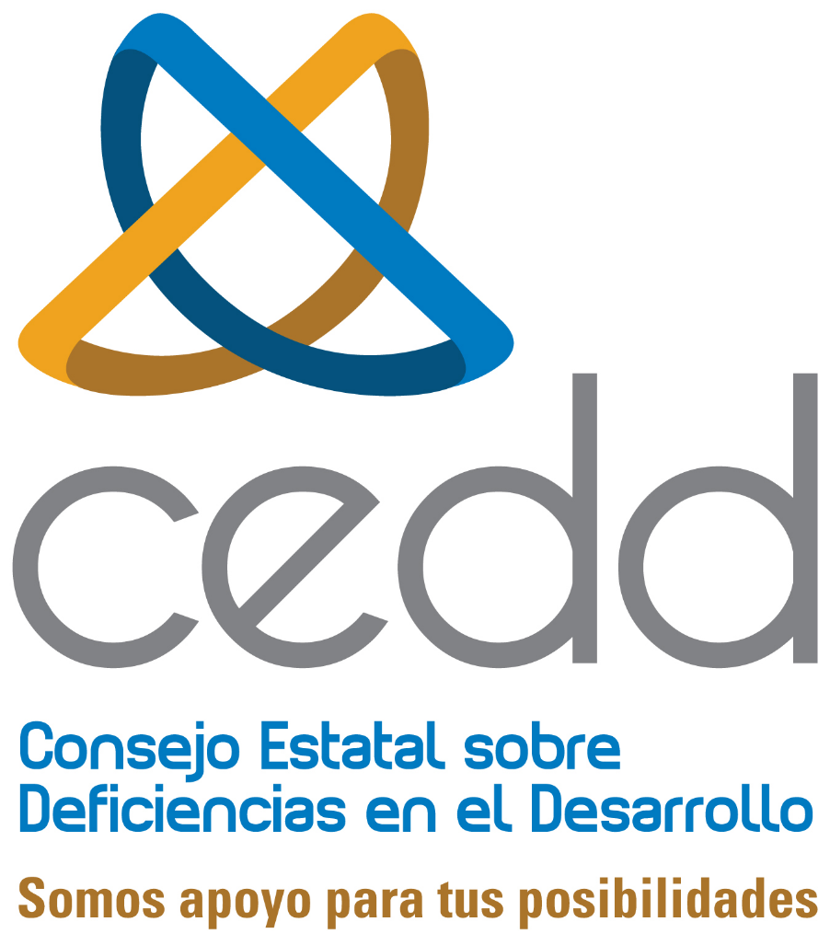
Puerto Rico Developmental Disabilities Council
Puerto Rico Developmental Disabilities Council works to promote full integration and inclusion of people with disabilities in all aspects of community life in the US and its territories.
Who We Are
Myrainne Z. Roa, Executive Director

Slide 41
University Center for Education on Development Deficiencies- University of Puerto Rico
Offers community training, educational activities, and continuing education in the area of developmental disabilities aimed at professionals, students, people with disabilities, families, and the community.
Who We Are
Dr. Carol Salas Pagán, Executive Director

Slide 42
What PRDCRN Did
Created an action plan that included:
Island wide distribution of municipalities among the PRDCRN agencies to visit shelters, elderly homes and hospitals to conduct a needs survey.
Creation of a call center where people with disabilities could informe their needs.
Establishment of a collection center to receive supplies and equipment to be handed out to people with disabilities
Outreach to partners and collaborators in the states

Slide 43
Response of the Puerto Rico Disability Community Relief Network at the impact of Hurricane María
More than 9,500 families were impacted by our services and supplies across 68 of the 78 municipalities in the island

Slide 44
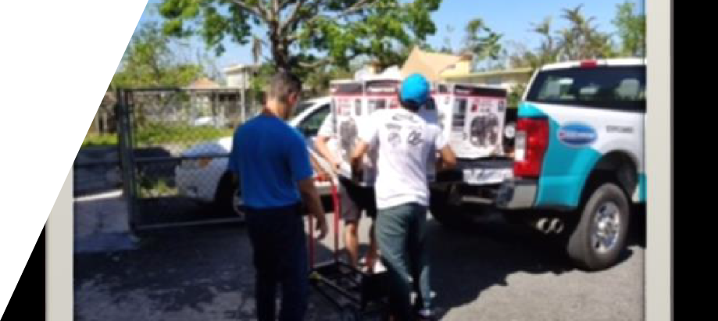
Supplies Handed Out By The PRDCRN
Food and water
Clothing and shoes
Medications
Assistive Equipment
Personal hygiene products
First aid supplies
Solar generators
Gasoline gift cards
Portable stoves

Slide 45
Our Collaborators
Bags of Love for Puerto Rico
Bass Berry Sims
Brotherhood of the Sea
Camphill Village
City of Houston, Texas
City of Houston Mayor’s Office for People with Disabilities
FODAC
FRESH Export Solutions
Marine Asset Management
National Shipping of America
Partnership for Inclusive Disaster Strategies
Portlight Inclusive Disaster Strategies
American Red Cross
Trach Mommas of Lousiana
Unidos por Puerto Rico
USSAAC
Fundación Flamboyán

Slide 46
The PRDCRNs Long Term Plan
Advocacy for the rights of people with disabilities
Capacity building for individuals, public and private organizations and communities
Dissemination of evidence based approaches
Research and Evaluation
Emergency Preparedness: Mitigation, Planning, Response, Recovery and

Slide 47
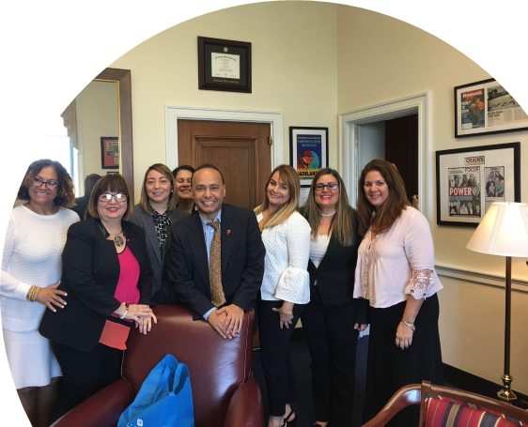
Accomplishments Of Long Term Plan (Part I)
We have advocated in the presence of local legislation that has been created in the aftermath of Maria.
We advocated with the PR Housing Department and at Capitol Hill in Washington, DC for the use of CDBG-DR funds and inclusion of people with disabilities in the investment of these funds.

Slide 48
Accomplishments Of Long Term Plan (Part II)
The PRDCRN is providing workshops for individuals and public or private agencies with regard to emergency preparedness and inclusive emergency plans.
It has worked very closely with FEMA throughout the response and recovery phases.

Slide 49
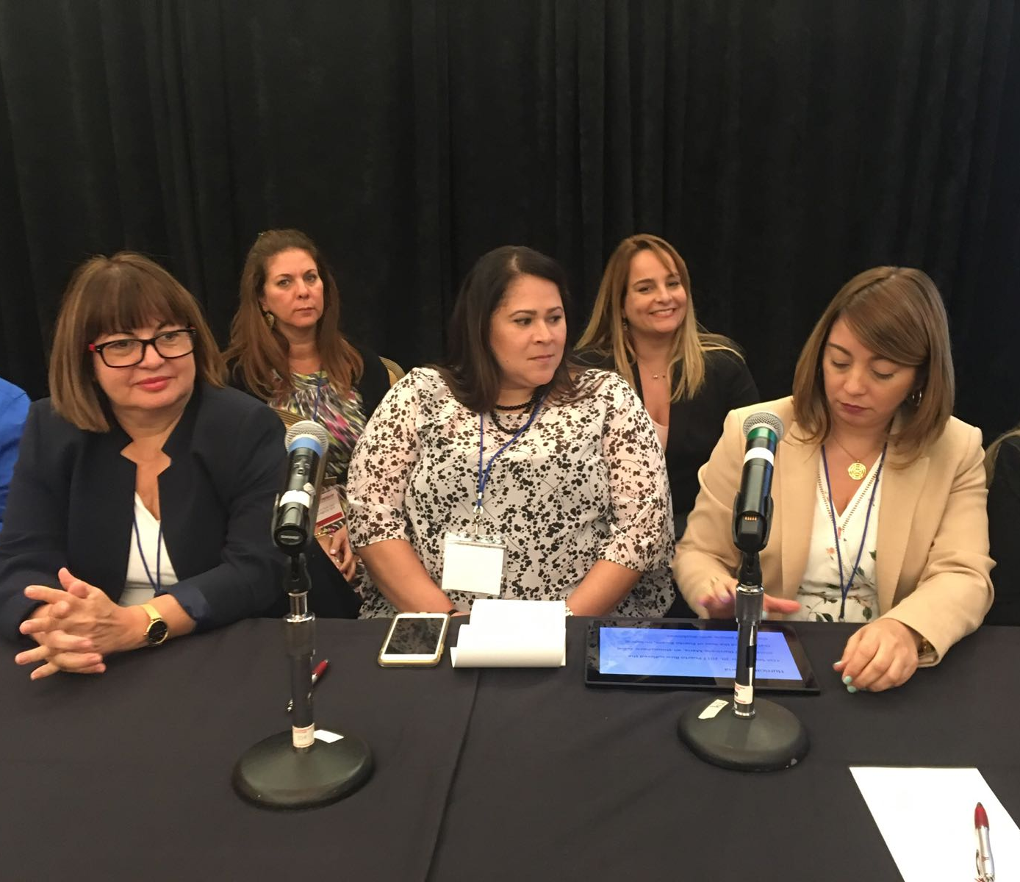
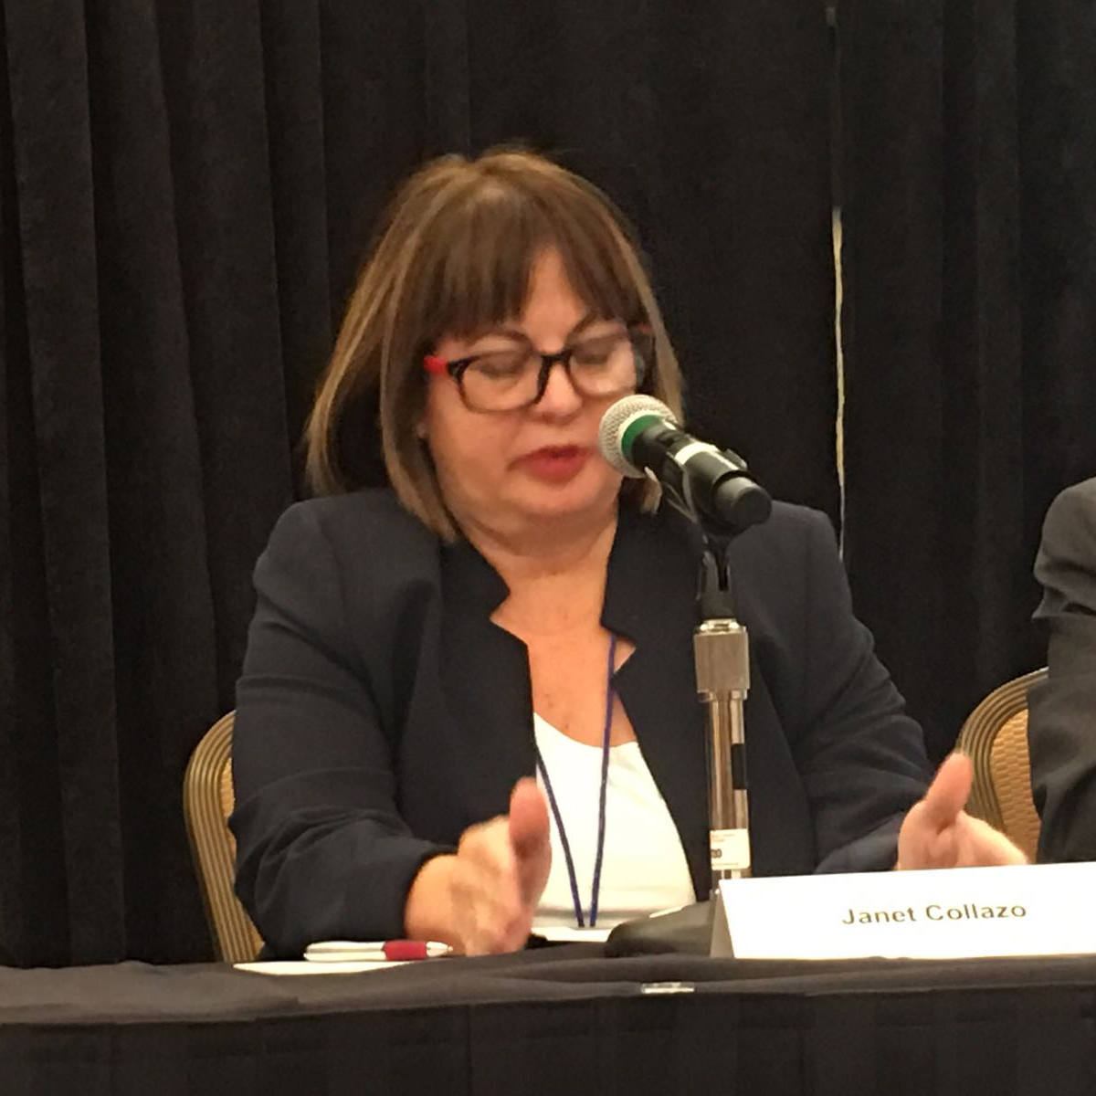
Accomplishments Of Long Term Plan (Part III)
We were invited to present the PRDCRN and our accomplishments in National Conferences such as Portlight Inclusive Disaster Strategies Getting It Right Conference in May 2018, the 2018 Annual Conference of the NACDD and the Virginia Emergency Management Conference in 2019.

Slide 50
Accomplishments Of Long Term Plan (Part IV)
The PRDCRN is actively participating in the development of the Core Advisory Groups that will bring together community disability organizations as a single voice before the Puerto Rico Emergency Management Agency (PREMA).
The network is actively participating in work groups and task forces involved in all the phases of emergency planning such as: Volunteer Organizations after Disasters (VOAD), Long Term Recovery Groups (LTRG), Strategic National Stockpile (SNS) Program, Red Cross Task Force, Portlight Inclusive Disaster Strategies Coalition, HUD Housing Plan work group, etc.

Slide 51
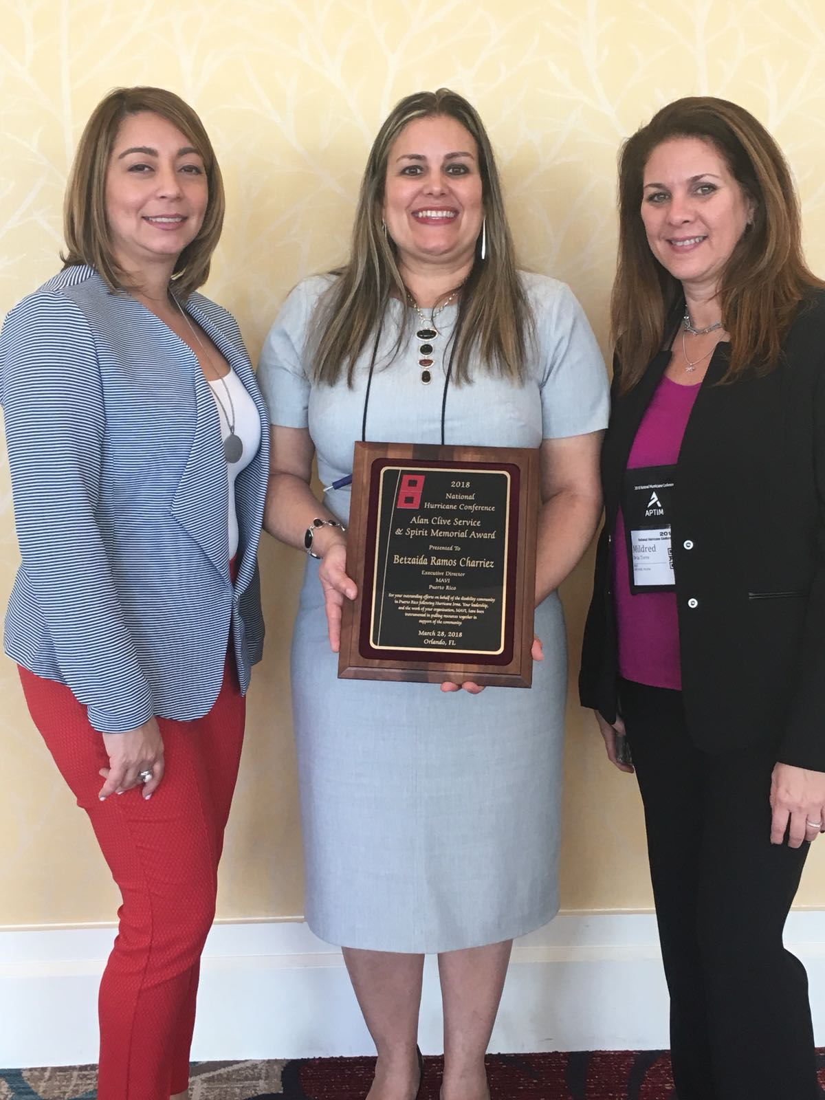
Accomplishments Of Long Term Plan (Part V)
Our efforts have been disseminated in Puerto Rico and the US, and as such received recognition with the Alan Clive Service and Memorial Award at the National Hurricane Conference in Orlando, Florida in February of 2018 for our response efforts with people with disabilities in the aftermath of the hurricane.
A stockpile of Durable Medical Equipment (DME) will continue to be available in the event of another emergency.

Slide 52
Where Is PR One Year Later (Part I)
As of September 2018, about 95% of the population had their power back on.
In October 2018, 100% had electricity, though a very fragile electrical system with constant interruptions.
100% of the population had water supply.
Temporary bridges have been built in communities that were isolated.

Slide 53
Where Is PR One Year Later (Part II)
100% of hospitals are fully or partially operational.
100% of communication systems are back in place and many companies are updating their systems.
FEMA approved 462,000 households with grants under the Individuals and Households Program. 62,000 people denied assistance filed appeals. 14,ooo of those appeals have been approved. 48,000 homes are still in the appeals process. Ineligibility rates for appeals in PR are 74.76%. (Letter from Michael Byrne, FEMA Federal Coordinating Officer, to Senator Robert Menéndez, August 14, 2018).

Slide 54
Where Is PR One Year Later (Part IV)
Most of these cases in the appeals process have not received aid from FEMA due to lack of evidence of ownership. Most of these families have been displaced from their homes or are still living with blue roofs while the new guidelines for determining ownership are being notified.

Slide 55
Where Is PR One Year Later (Part V)
119,931 homes received approval for TEMPORARY repairs with the “Tu Hogar Renace” (Your Home Reborn) Program. As of June 2018, 75,826 have begun to receive repairs and 34,097 have completed repairs. 6% of the recipients have complained due to the cost, quality and fragility of the repairs.
(Data offered by PR Housing Secretary Fernando Gil Ensenat at public hearing at the PR House of Representatives on June 25, 2018).

Slide 56
Where Is PR One Year Later (Part VI)
As of July, 2018, 1,744 people were still displaced in the US under the TSA Program (The source.com, July 2, 2018).
On August 1, the program was once again extended to August 31, 2018 (National Public Radio, Inc., August 1, 2018).
The program provided temporary shelter and return airfare to PR for displaced families. The majority of these families had no homes to return to.

Slide 57
Where Do We Go From Here
Continue capacity building among individuals with disabilities, the communities and emergency responders at municipal and state levels.
Continue disseminating results to expand funding opportunities that will promote the sustainability of the PRDCRN.
Continue advocating among state government to ensure the network’s SEAT AT THE TABLE in inclusive emergency preparedness plans.

Slide 58
Vision
All people with disabilities are safe and secure before, during and after a disaster.
Become the recognized network that advances policies and practices that improve system standards of emergency preparedness for the well being of people with disabilities in Puerto Rico.

Slide 59
KEEP CALM WE ARE STILL GOING STRONG
Keep calm

Slide 60
Thank you

